Slide 1
Forward Kinematics of Robot Manipulators
Class at Wentworth Institute of Technology
Yue Cao Purdue University, ECE yuecao@purdue.edu

Slide 2
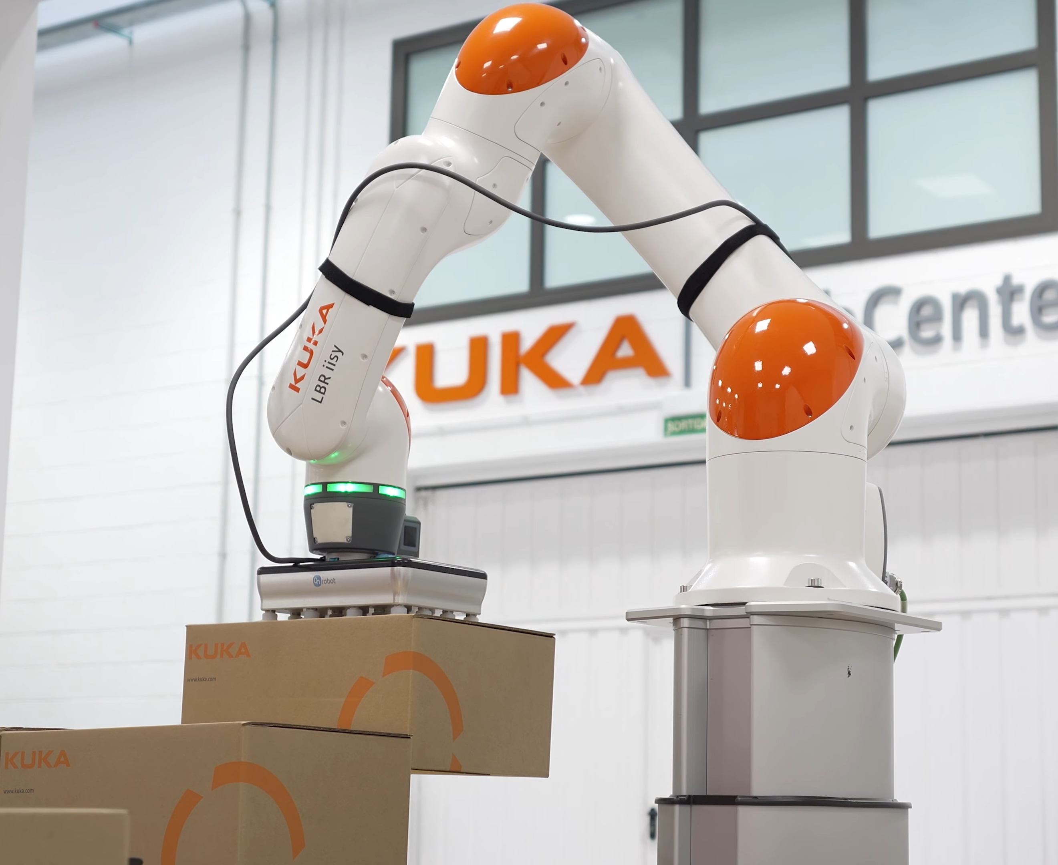
Terminology – Manipulator
Link
Joint
End-effector
Base

Slide 3
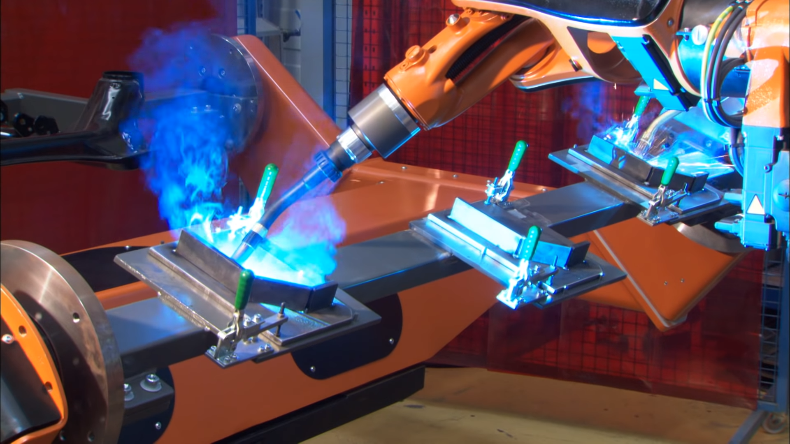
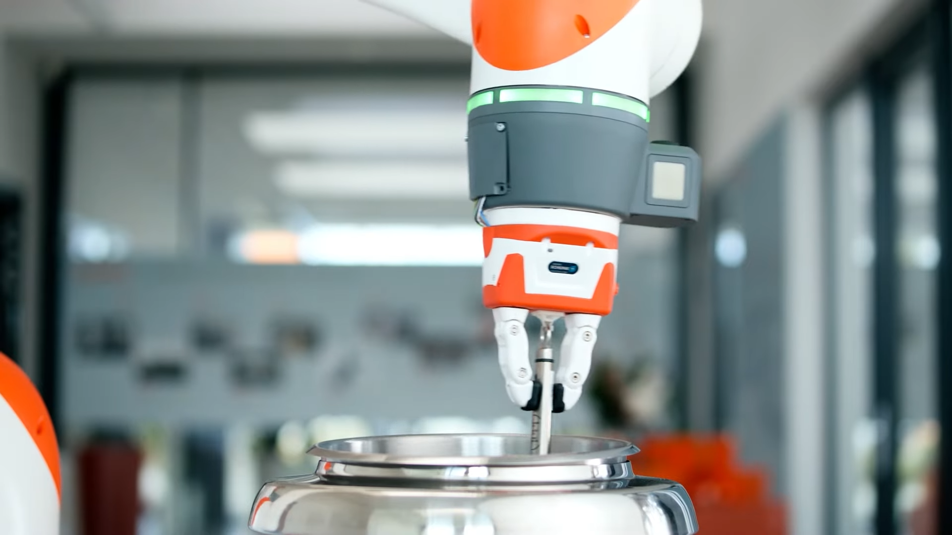
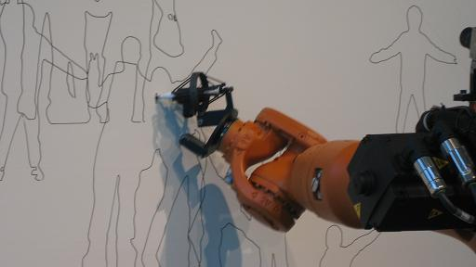
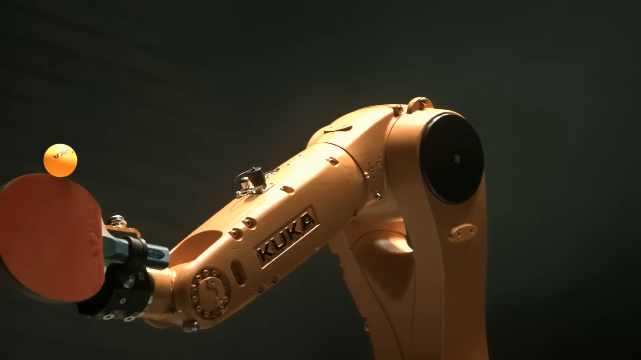
Terminology – Manipulator
A variety of end-effectors

Slide 4
Definition
kinematics
dynamics
forward kinematics
inverse kinematics
forward dynamics
inverse dynamics
What is kinematics? The study of motion without regard for the force.
For manipulators:
Joint angles ↔ End-effector position & orientation

Slide 5
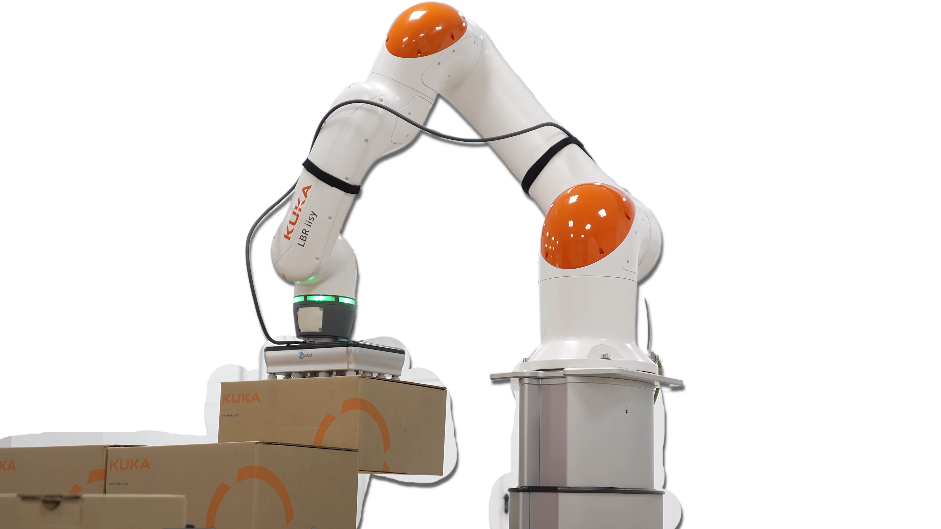
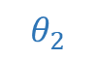
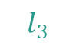
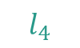
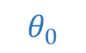
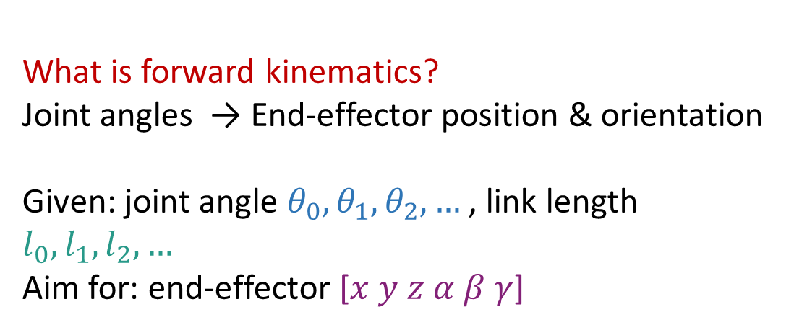

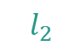
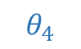
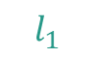
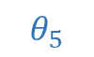


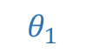
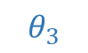
Definition
kinematics
dynamics
$$l_{2}$$
$$θ_{3}$$
forward kinematics
inverse kinematics
forward dynamics
inverse dynamics
$$l_{1}$$
$$l_{3}$$
$$θ_{2}$$
What is forward kinematics? Joint angles → End-effector position & orientation
Given: joint angle ${θ_{0}, θ}_{1},θ_{2}, …$ , link length $l_{0}, l_{1}, l_{2}, …$ Aim for: end-effector [$x y z α β γ$]
$$θ_{4}$$
$$θ_{1}$$
$$l_{4}$$
$$l_{0}$$
$$θ_{5}$$
$$θ_{0}$$
$$Base$$
$x y z$: position in the Cartesian coordinate.
$α β γ$: orientation in Euler angles.

Slide 6
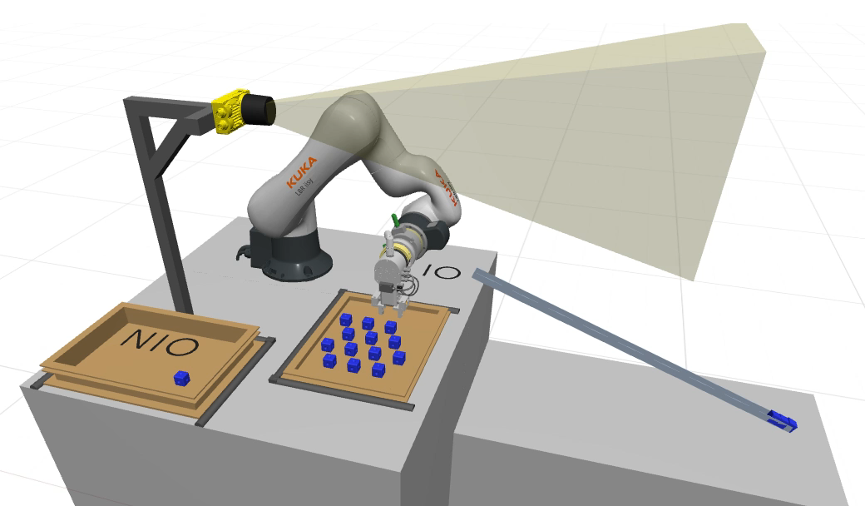

Slide 7
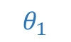

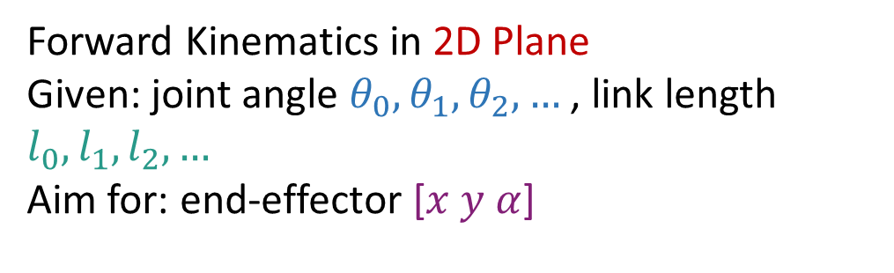
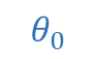

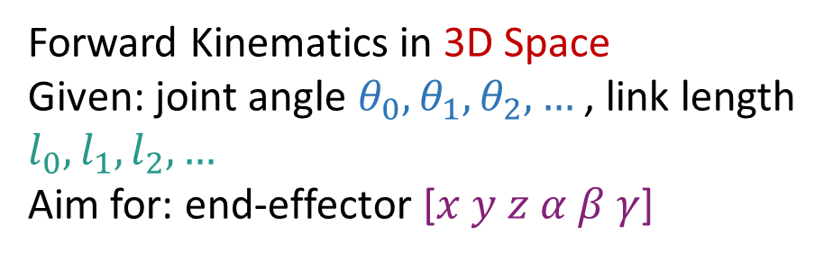
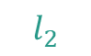





Start with 2D Plane
Forward Kinematics in 3D Space Given: joint angle ${θ_{0}, θ}_{1},θ_{2}, …$ , link length $l_{0}, l_{1}, l_{2}, …$ Aim for: end-effector [$x y z α β γ$]
$$θ_{2}$$
$$y$$
$$θ_{1}$$
$$l_{2}$$
$$l_{1}$$
$$α$$
Forward Kinematics in 2D Plane Given: joint angle ${θ_{0}, θ}_{1},θ_{2}, …$ , link length $l_{0}, l_{1}, l_{2}, …$ Aim for: end-effector [$x y α$]
$$l_{0}$$
$$θ_{0}$$
$$Base$$
$$x$$
[$x y α$] is with respect to the base coordinate frame.

Slide 8

2D Forward Kinematics
How to obtain [$x y α$] ?
Approach 1: Directly analyze the geometry
$$θ_{2}$$
$$y$$
$$θ_{1}$$
$$l_{2}$$
$$l_{1}$$
$$α$$
$$l_{0}$$
$$θ_{0}$$
$$Base$$
$$x$$

Slide 9
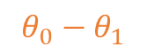
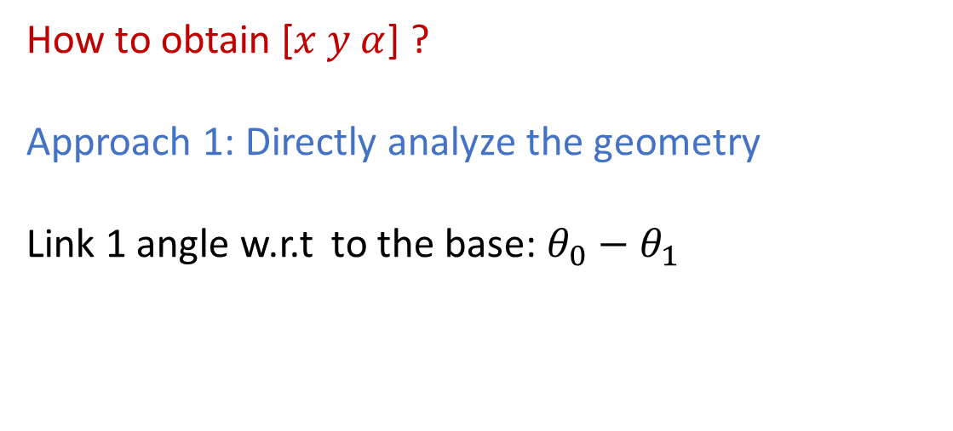
2D Forward Kinematics
How to obtain [$x y α$] ?
Approach 1: Directly analyze the geometry
Link 1 angle w.r.t to the base: $θ_{0}−θ_{1}$
$$θ_{2}$$
$$y$$
$$θ_{1}$$
$$l_{2}$$
$$l_{1}$$
$$α$$
$$θ_{0}−θ_{1}$$
$$l_{0}$$
$$θ_{0}$$
$$Base$$
$$x$$
w.r.t: with respect to, means use the specified coordinate frame as a reference

Slide 10
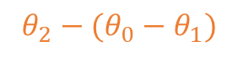
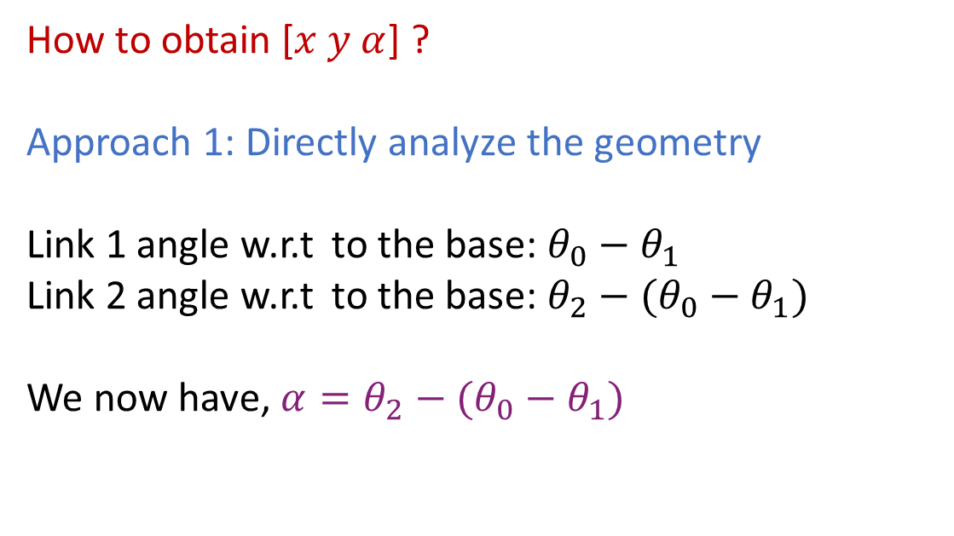
2D Forward Kinematics
How to obtain [$x y α$] ?
Approach 1: Directly analyze the geometry
Link 1 angle w.r.t to the base: $θ_{0}−θ_{1}$
Link 2 angle w.r.t to the base: $θ_{2}−(θ_{0}−θ_{1})$
We now have, $α=θ_{2}−(θ_{0}−θ_{1})$
$$θ_{2}$$
$$θ_{2}−(θ_{0}−θ_{1})$$
$$y$$
$$θ_{1}$$
$$l_{2}$$
$$l_{1}$$
$$α$$
$$θ_{0}−θ_{1}$$
$$l_{0}$$
$$θ_{0}$$
$$Base$$
$$x$$
w.r.t: with respect to, means use the specified coordinate frame as a reference

Slide 11
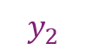
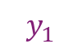
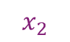
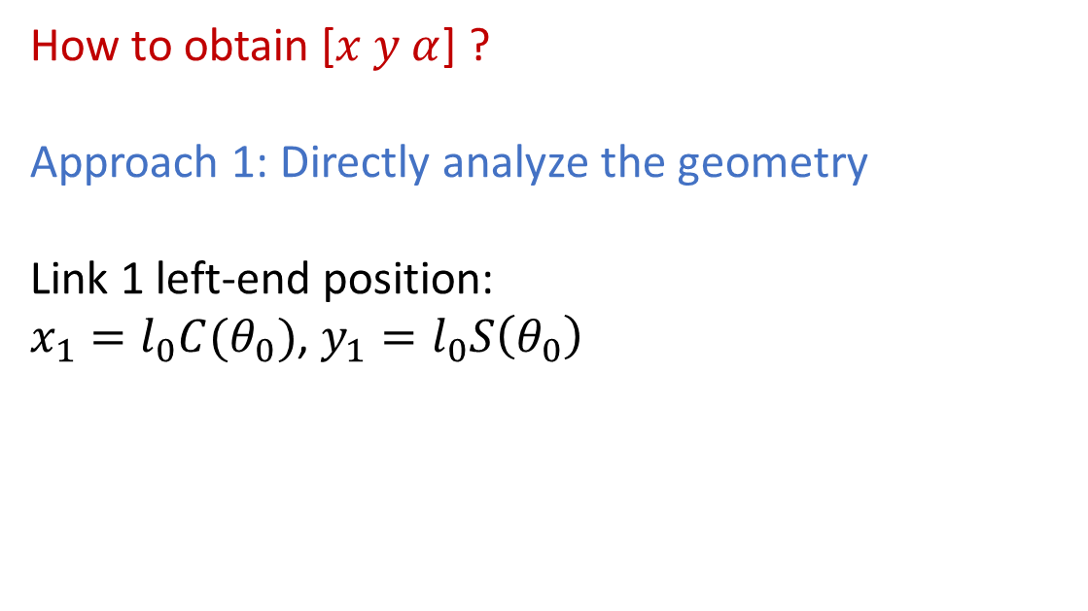
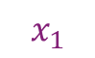
2D Forward Kinematics
How to obtain [$x y α$] ?
Approach 1: Directly analyze the geometry
Link 1 left-end position: $x_{1}=l_{0}C(θ_{0})$, $y_{1}=l_{0}S\left(θ_{0}\right)$
$$y_{2}$$
$$θ_{2}$$
$$θ_{2}−(θ_{0}−θ_{1})$$
$$y$$
$$θ_{1}$$
$$l_{2}$$
$$l_{1}$$
$$α$$
$$y_{1}$$
$$θ_{0}−θ_{1}$$
$$l_{0}$$
$$θ_{0}$$
$$Base$$
$$x_{1}$$
$$x_{2}$$
$$x$$
$S\left(θ\right)$ is short for $sin \left(θ\right)$, $C\left(θ\right)$ is short for $cos \left(θ\right)$

Slide 12
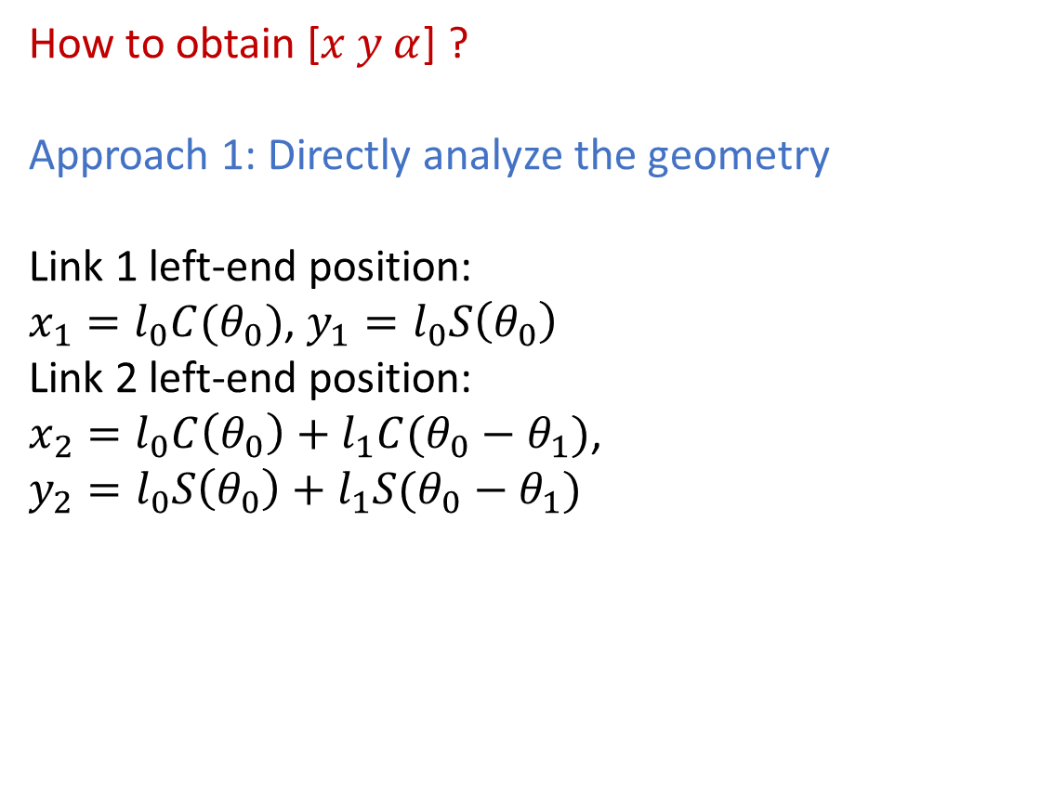
2D Forward Kinematics
How to obtain [$x y α$] ?
Approach 1: Directly analyze the geometry
Link 1 left-end position: $x_{1}=l_{0}C(θ_{0})$, $y_{1}=l_{0}S\left(θ_{0}\right)$
Link 2 left-end position: $x_{2}=l_{0}C\left(θ_{0}\right)+l_{1}C(θ_{0}−θ_{1})$, $y_{2}=l_{0}S\left(θ_{0}\right)+l_{1}S(θ_{0}−θ_{1})$
$$y_{2}$$
$$θ_{2}$$
$$θ_{2}−(θ_{0}−θ_{1})$$
$$y$$
$$θ_{1}$$
$$l_{2}$$
$$l_{1}$$
$$α$$
$$y_{1}$$
$$θ_{0}−θ_{1}$$
$$l_{0}$$
$$θ_{0}$$
$$Base$$
$$x_{1}$$
$$x_{2}$$
$$x$$
$S\left(θ\right)$ is short for $sin \left(θ\right)$, $C\left(θ\right)$ is short for $cos \left(θ\right)$

Slide 13
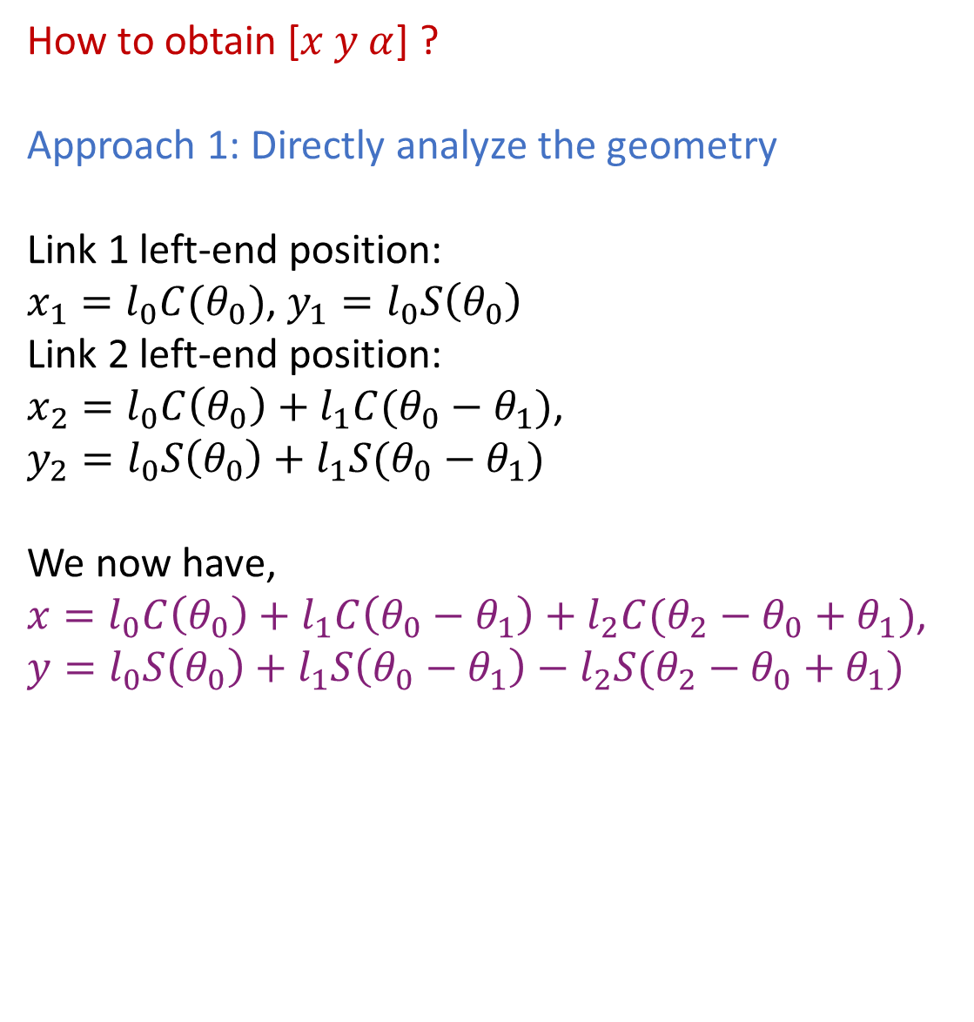
2D Forward Kinematics
How to obtain [$x y α$] ?
Approach 1: Directly analyze the geometry
Link 1 left-end position: $x_{1}=l_{0}C(θ_{0})$, $y_{1}=l_{0}S\left(θ_{0}\right)$
Link 2 left-end position: $x_{2}=l_{0}C\left(θ_{0}\right)+l_{1}C(θ_{0}−θ_{1})$, $y_{2}=l_{0}S\left(θ_{0}\right)+l_{1}S(θ_{0}−θ_{1})$
We now have, $x=l_{0}C\left(θ_{0}\right)+l_{1}C\left(θ_{0}−θ_{1}\right)+l_{2}C(θ_{2}−θ_{0}+θ_{1})$, $y=l_{0}S\left(θ_{0}\right)+l_{1}S\left(θ_{0}−θ_{1}\right)−l_{2}S(θ_{2}−θ_{0}+θ_{1})$
$$y_{2}$$
$$θ_{2}$$
$$θ_{2}−(θ_{0}−θ_{1})$$
$$y$$
$$θ_{1}$$
$$l_{2}$$
$$l_{1}$$
$$α$$
$$y_{1}$$
$$θ_{0}−θ_{1}$$
$$l_{0}$$
$$θ_{0}$$
$$Base$$
$$x_{1}$$
$$x_{2}$$
$$x$$
$S\left(θ\right)$ is short for $sin \left(θ\right)$, $C\left(θ\right)$ is short for $cos \left(θ\right)$

Slide 14
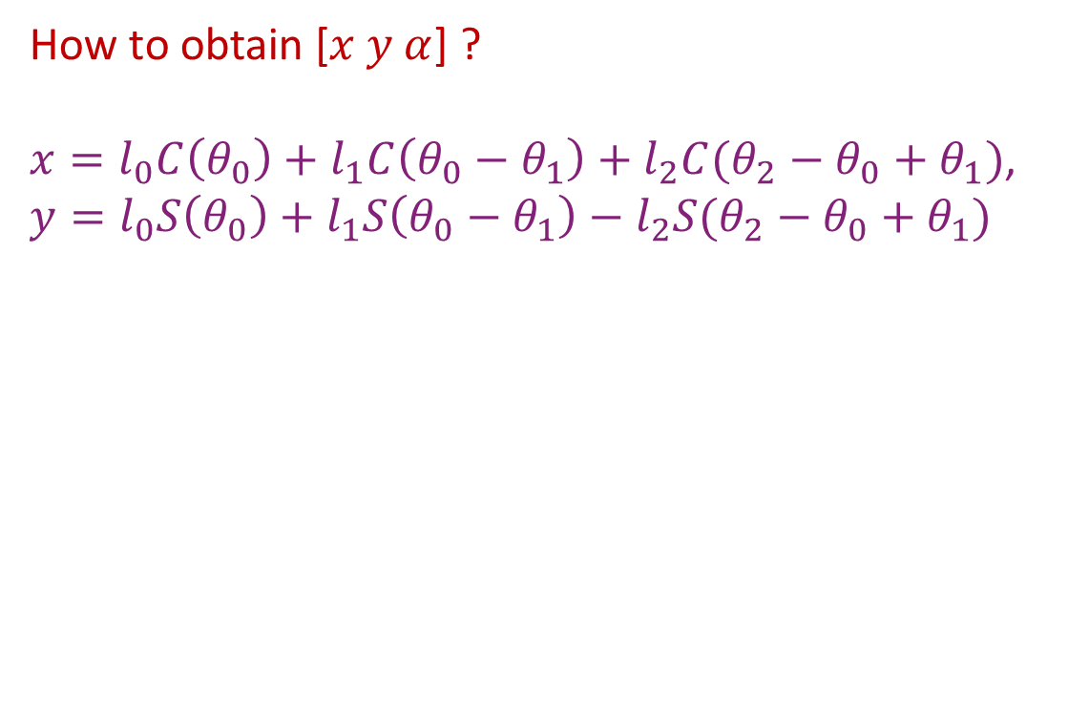
2D Forward Kinematics
How to obtain [$x y α$] ?
$x=l_{0}C\left(θ_{0}\right)+l_{1}C\left(θ_{0}−θ_{1}\right)+l_{2}C(θ_{2}−θ_{0}+θ_{1})$, $y=l_{0}S\left(θ_{0}\right)+l_{1}S\left(θ_{0}−θ_{1}\right)−l_{2}S(θ_{2}−θ_{0}+θ_{1})$
$$y_{2}$$
$$θ_{2}$$
$$θ_{2}−(θ_{0}−θ_{1})$$
$$y$$
$$θ_{1}$$
$$l_{2}$$
$$l_{1}$$
$$α$$
$$y_{1}$$
$$θ_{0}−θ_{1}$$
$$l_{0}$$
$$θ_{0}$$
$$Base$$
$$x_{1}$$
$$x_{2}$$
$$x$$
$S\left(θ\right)$ is short for $sin \left(θ\right)$, $C\left(θ\right)$ is short for $cos \left(θ\right)$

Slide 15
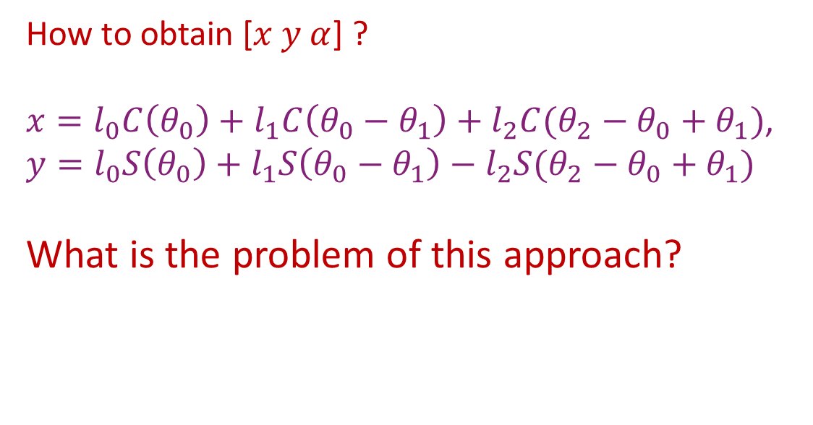
2D Forward Kinematics
How to obtain [$x y α$] ?
$x=l_{0}C\left(θ_{0}\right)+l_{1}C\left(θ_{0}−θ_{1}\right)+l_{2}C(θ_{2}−θ_{0}+θ_{1})$, $y=l_{0}S\left(θ_{0}\right)+l_{1}S\left(θ_{0}−θ_{1}\right)−l_{2}S(θ_{2}−θ_{0}+θ_{1})$ What is the problem of this approach?
$$y_{2}$$
$$θ_{2}$$
$$θ_{2}−(θ_{0}−θ_{1})$$
$$y$$
$$θ_{1}$$
$$l_{2}$$
$$l_{1}$$
$$α$$
$$y_{1}$$
$$θ_{0}−θ_{1}$$
$$l_{0}$$
$$θ_{0}$$
$$Base$$
$$x_{1}$$
$$x_{2}$$
$$x$$
$S\left(θ\right)$ is short for $sin \left(θ\right)$, $C\left(θ\right)$ is short for $cos \left(θ\right)$

Slide 16
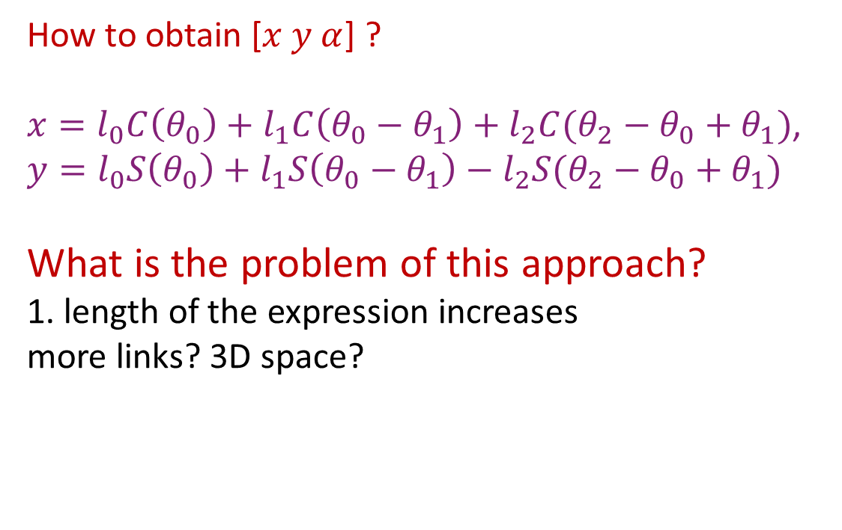
2D Forward Kinematics
How to obtain [$x y α$] ?
$x=l_{0}C\left(θ_{0}\right)+l_{1}C\left(θ_{0}−θ_{1}\right)+l_{2}C(θ_{2}−θ_{0}+θ_{1})$, $y=l_{0}S\left(θ_{0}\right)+l_{1}S\left(θ_{0}−θ_{1}\right)−l_{2}S(θ_{2}−θ_{0}+θ_{1})$ What is the problem of this approach? 1. length of the expression increases more links? 3D space?
$$y_{2}$$
$$θ_{2}$$
$$θ_{2}−(θ_{0}−θ_{1})$$
$$y$$
$$θ_{1}$$
$$l_{2}$$
$$l_{1}$$
$$α$$
$$y_{1}$$
$$θ_{0}−θ_{1}$$
$$l_{0}$$
$$θ_{0}$$
$$Base$$
$$x_{1}$$
$$x_{2}$$
$$x$$
$S\left(θ\right)$ is short for $sin \left(θ\right)$, $C\left(θ\right)$ is short for $cos \left(θ\right)$

Slide 17
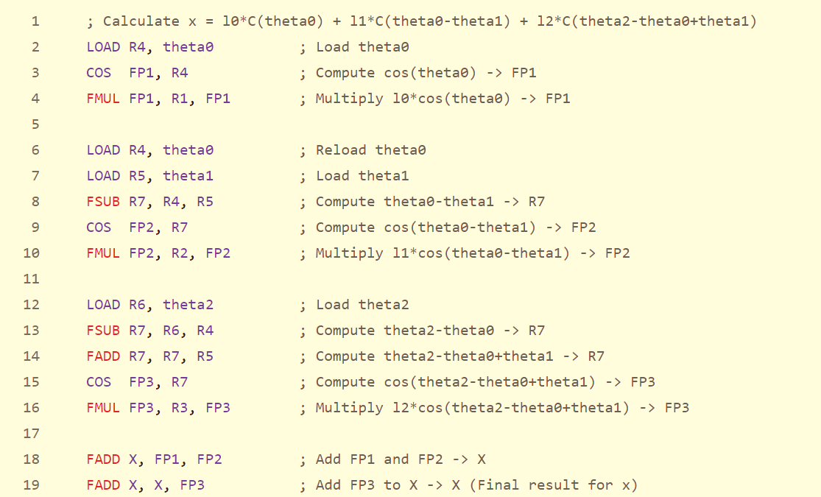
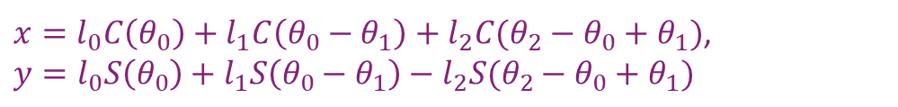
$x=l_{0}C\left(θ_{0}\right)+l_{1}C\left(θ_{0}−θ_{1}\right)+l_{2}C(θ_{2}−θ_{0}+θ_{1})$, $y=l_{0}S\left(θ_{0}\right)+l_{1}S\left(θ_{0}−θ_{1}\right)−l_{2}S(θ_{2}−θ_{0}+θ_{1})$
Python
Assembly

Slide 18
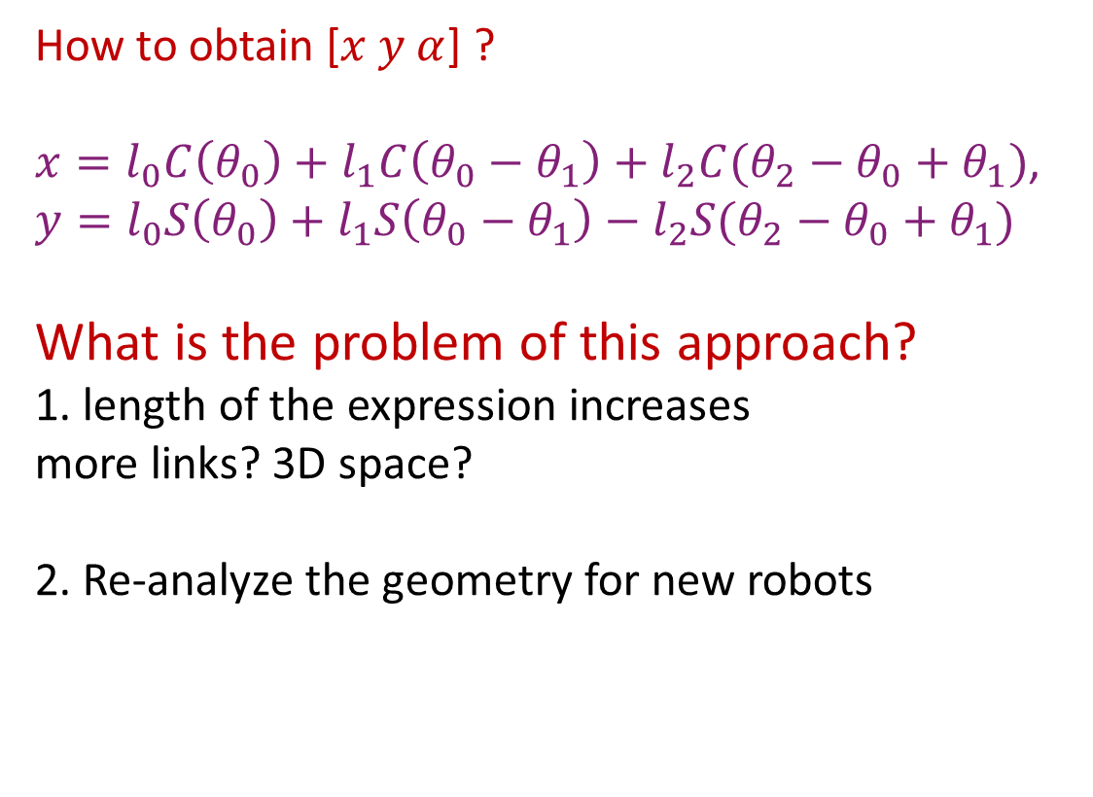
2D Forward Kinematics
How to obtain [$x y α$] ?
$x=l_{0}C\left(θ_{0}\right)+l_{1}C\left(θ_{0}−θ_{1}\right)+l_{2}C(θ_{2}−θ_{0}+θ_{1})$, $y=l_{0}S\left(θ_{0}\right)+l_{1}S\left(θ_{0}−θ_{1}\right)−l_{2}S(θ_{2}−θ_{0}+θ_{1})$ What is the problem of this approach? 1. length of the expression increases more links? 3D space? 2. Re-analyze the geometry for new robots
$$y_{2}$$
$$θ_{2}$$
$$θ_{2}−(θ_{0}−θ_{1})$$
$$y$$
$$θ_{1}$$
$$l_{2}$$
$$l_{1}$$
$$α$$
$$y_{1}$$
$$θ_{0}−θ_{1}$$
$$l_{0}$$
$$θ_{0}$$
$$Base$$
$$x_{1}$$
$$x_{2}$$
$$x$$
$S\left(θ\right)$ is short for $sin \left(θ\right)$, $C\left(θ\right)$ is short for $cos \left(θ\right)$

Slide 19
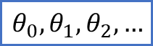


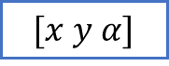

2D Forward Kinematics
How to obtain [$x y α$] ?
We want to a systematic approach.
$$θ_{2}$$
$$y$$
$$θ_{1}$$
$$l_{2}$$
$$l_{1}$$
$$α$$
$$l_{0}$$
$$θ_{0}$$
$${θ_{0}, θ}_{1},θ_{2}, …$$
$$Base$$
$$x$$
$$?$$
$$[x y α]$$
$$l_{0}, l_{1}, l_{2}, …$$
How to build such box?

Slide 20


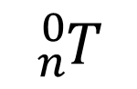



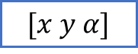
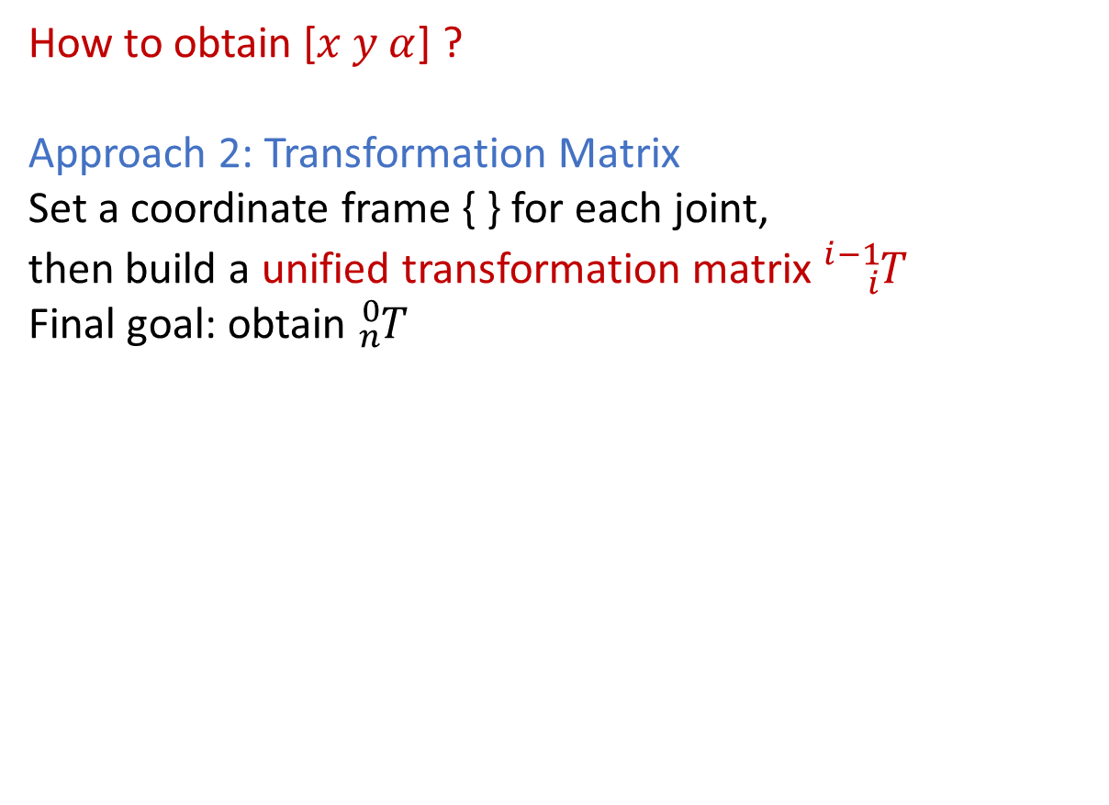
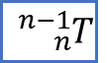

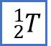



2D Forward Kinematics
How to obtain [$x y α$] ?
Approach 2: Transformation Matrix
Set a coordinate frame { } for each joint, then build a unified transformation matrix ${}_{i}^{i−1}T$ Final goal: obtain ${}_{n}^{0}T$
$\{2\}$
$\{1\}$
$$θ_{2}$$
$$y$$
$$θ_{1}$$
$$l_{2}$$
$$l_{1}$$
$$α$$
$\{3\}$
$$l_{0}$$
$\{0\}$
$$θ_{0}$$
$${θ_{0}, θ}_{1},θ_{2}, …$$
$${}_{1}^{0}T$$
$${}_{n}^{0}T$$
$$Base$$
$$x$$
$${}_{2}^{1}T$$
$$[x y α]$$
$$l_{0}, l_{1}, l_{2}, …$$
$$…$$
$${}_{n}^{n−1}T$$
${}_{B}^{A}T$ : describe frame $\{B\}$ w.r.t frame $\{A\}$

Slide 21
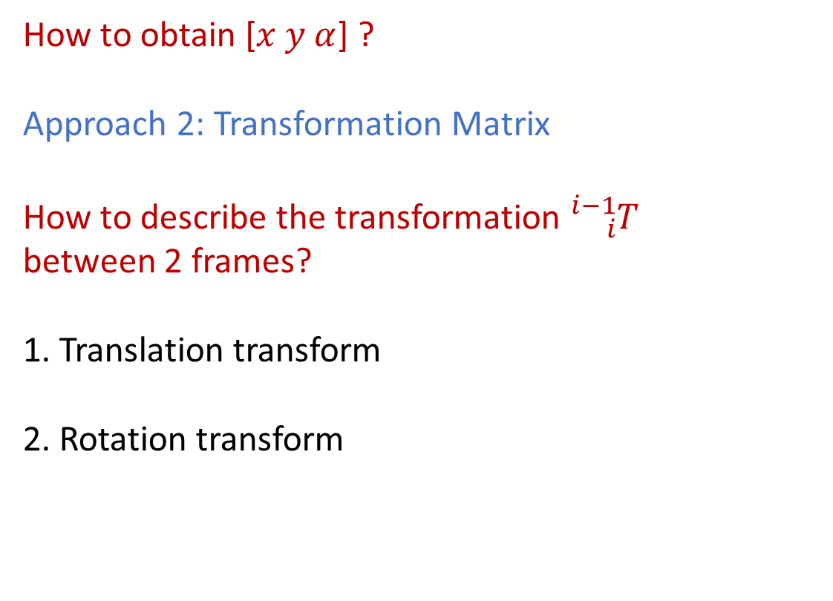
2D Forward Kinematics
How to obtain [$x y α$] ?
Approach 2: Transformation Matrix
How to describe the transformation ${}_{i}^{i−1}T$ between 2 frames?
1. Translation transform
2. Rotation transform
$\{2\}$
$\{1\}$
$$θ_{2}$$
$$y$$
$$θ_{1}$$
$$l_{2}$$
$$l_{1}$$
$$α$$
$\{3\}$
$$l_{0}$$
$\{0\}$
$$θ_{0}$$
$$Base$$
$$x$$

Slide 22


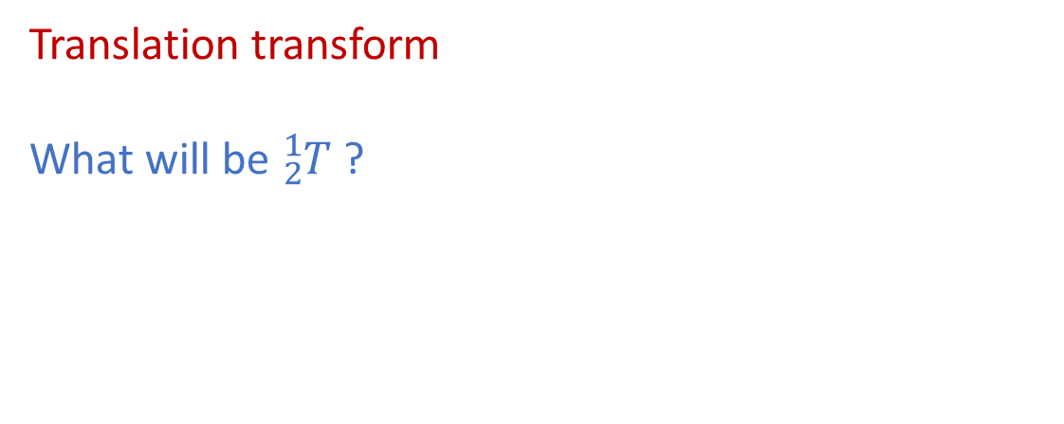


2D Forward Kinematics
$\{2\}$
Translation transform
What will be ${}_{2}^{1}T$ ?
$\{1\}$
$$a$$
$$b$$
${}_{B}^{A}T$ : describe frame $\{B\}$ w.r.t frame $\{A\}$

Slide 23


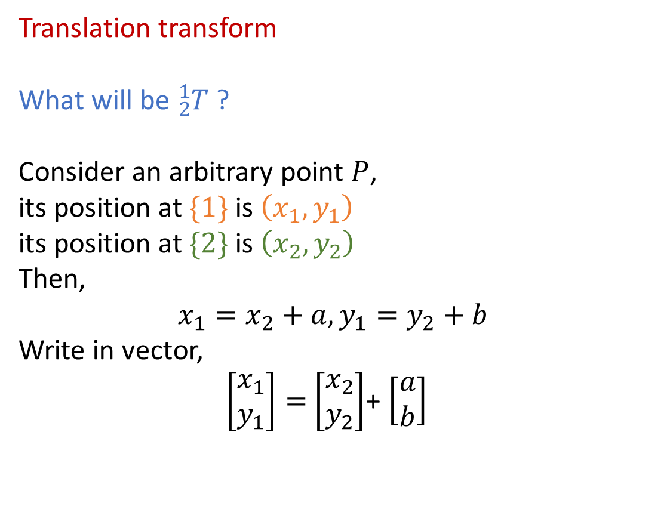



2D Forward Kinematics
$\{2\}$
Translation transform
What will be ${}_{2}^{1}T$ ?
Consider an arbitrary point $P$, its position at $\{1\}$ is $\left(x_{1},y_{1}\right)$ its position at $\{2\}$ is $\left(x_{2},y_{2}\right)$
Then,
$$x_{1}=x_{2}+a, y_{1}=y_{2}+b$$
Write in vector,
$\left[\begin{aligned}x_{1} \\ y_{1}\end{aligned}\right]=$ $\left[\begin{aligned}x_{2} \\ y_{2}\end{aligned}\right]$+ $\left[\begin{aligned}a \\ b\end{aligned}\right]$
$\{1\}$
$$y_{1}$$
$$y_{2}$$
$P$
$$x_{2}$$
$$a$$
$$b$$
$$x_{1}$$
${}_{B}^{A}T$ : describe frame $\{B\}$ w.r.t frame $\{A\}$

Slide 24





2D Forward Kinematics
$\{2\}$
Translation transform
Example
Given P at $\{2\}$ is $\left(1, 2.5\right)$ , $a=b=2$
Then,
$$x_{1}=1+a, y_{1}=2.5+b$$
Write in vector,
$\left[\begin{aligned}x_{1} \\ y_{1}\end{aligned}\right]=\left[\begin{aligned}x_{2} \\ y_{2}\end{aligned}\right]$+ $\left[\begin{aligned}a \\ b\end{aligned}\right]=\left[\begin{aligned}1 \\ 2.5\end{aligned}\right]$+ $\left[\begin{aligned}a \\ b\end{aligned}\right]=$ $\left[\begin{aligned}1 \\ 2.5\end{aligned}\right]$+ $\left[\begin{aligned}2 \\ 2\end{aligned}\right]$= $\left[\begin{aligned}3 \\ 4.5\end{aligned}\right]$
$\{1\}$
$$y_{1}$$
$$y_{2}=2.5$$
$P$
$$x_{2}=1$$
$$a=2$$
$$b=2$$
$$x_{1}$$
${}_{B}^{A}T$ : describe frame $\{B\}$ w.r.t frame $\{A\}$

Slide 25



2D Forward Kinematics
Rotation transform
What will be ${}_{2}^{1}T$ ?
$\{1\}$
$\{2\}$
$$θ$$
${}_{B}^{A}T$ : describe frame $\{B\}$ w.r.t frame $\{A\}$

Slide 26






2D Forward Kinematics
Rotation transform
What will be ${}_{2}^{1}T$ ? Consider an arbitrary point $P$, its position at $\{1\}$ is $\left(x_{1},y_{1}\right)$ its position at $\{2\}$ is $\left(x_{2},y_{2}\right)$
$\{1\}$
$\{2\}$
$P$
$$y_{1}$$
$$y_{2}$$
$$x_{2}$$
$$θ$$
$$x_{1}$$
${}_{B}^{A}T$ : describe frame $\{B\}$ w.r.t frame $\{A\}$

Slide 27



2D Forward Kinematics
Rotation transform
What will be ${}_{2}^{1}T$ ? Consider an arbitrary point $P$, its position at $\{1\}$ is $\left(x_{1},y_{1}\right)$ its position at $\{2\}$ is $\left(x_{2},y_{2}\right)$
$$x_{1}=x_{2}C\left(θ\right)−y_{2}S\left(θ\right), { y}_{1}={x_{2}S\left(θ\right)+y}_{2}C\left(θ\right)$$ $\text{Write} \text{in} \text{vector}\text{,}$ $$\left[\begin{aligned}x_{1} \\ y_{1}\end{aligned}\right]=\left[\begin{matrix}C(θ) & −S(θ) \\ S(θ) & C(θ)\end{matrix}\right]\left[\begin{aligned}x_{2} \\ y_{2}\end{aligned}\right]$$
$\{1\}$
$\{2\}$
$P$
$$y_{1}$$
$$θ$$
$$y_{2}$$
$$y_{2}$$
$$x_{2}$$
$$θ$$
$$x_{1}$$
$S\left(θ\right)$ is short for $sin \left(θ\right)$, $C\left(θ\right)$ is short for $cos \left(θ\right)$

Slide 28




2D Forward Kinematics
Rotation transform
Example Given P at $\{2\}$ is $\left(3, 2\right)$ , 𝜃=30°
$$\left[\begin{aligned}x_{1} \\ y_{1}\end{aligned}\right]=\left[\begin{matrix}C(θ) & −S(θ) \\ S(θ) & C(θ)\end{matrix}\right]\left[\begin{aligned}x_{2} \\ y_{2}\end{aligned}\right]=\left[\begin{matrix}C(30°) & −S(30°) \\ S(30°) & C(30°)\end{matrix}\right]\left[\begin{aligned}3 \\ 2\end{aligned}\right]=\left[\begin{aligned}1.60 \\ 3.23\end{aligned}\right]$$
$\{1\}$
$\{2\}$
$P$
$$y_{1}$$
$$y_{2}=2$$
$$x_{2}=3$$
$$θ=30°$$
$$x_{1}$$
$S\left(θ\right)$ is short for $sin \left(θ\right)$, $C\left(θ\right)$ is short for $cos \left(θ\right)$

Slide 29






2D Forward Kinematics
Translation transform
$\left[\begin{aligned}x_{1} \\ y_{1}\end{aligned}\right]=$ $\left[\begin{aligned}x_{2} \\ y_{2}\end{aligned}\right]$+ $\left[\begin{aligned}a \\ b\end{aligned}\right]$
Unified Expression for ${}_{i}^{i−1}T$!
$$\left[\begin{aligned}x_{i−1} \\ y_{i−1} \\ 1\end{aligned}\right]={}_{i}^{i−1}{T\left[\begin{aligned}x_{i} \\ y_{i} \\ 1\end{aligned}\right]=}\left[\begin{matrix}C\left(θ\right) & −S\left(θ\right) & a \\ \begin{aligned}S\left(θ\right) \\ 0\end{aligned} & \begin{aligned}C\left(θ\right) \\ 0\end{aligned} & \begin{aligned}b \\ 1\end{aligned}\end{matrix}\right]\left[\begin{aligned}x_{i} \\ y_{i} \\ 1\end{aligned}\right]$$
Rotation transform
$\left[\begin{aligned}x_{1} \\ y_{1}\end{aligned}\right]=\left[\begin{matrix}C(θ) & −S(θ) \\ S(θ) & C(θ)\end{matrix}\right]\left[\begin{aligned}x_{2} \\ y_{2}\end{aligned}\right]$
Homogeneous Transformation Matrix

Slide 30

2D Forward Kinematics
Translation transform
$\left[\begin{aligned}x_{1} \\ y_{1}\end{aligned}\right]=$ $\left[\begin{aligned}x_{2} \\ y_{2}\end{aligned}\right]$+ $\left[\begin{aligned}a \\ b\end{aligned}\right]$
Unified Expression for ${}_{i}^{i−1}T$!
$$\left[\begin{aligned}x_{i−1} \\ y_{i−1} \\ 1\end{aligned}\right]={}_{i}^{i−1}{T\left[\begin{aligned}x_{i} \\ y_{i} \\ 1\end{aligned}\right]=}\left[\begin{matrix}C\left(θ\right) & −S\left(θ\right) & a \\ \begin{aligned}S\left(θ\right) \\ 0\end{aligned} & \begin{aligned}C\left(θ\right) \\ 0\end{aligned} & \begin{aligned}b \\ 1\end{aligned}\end{matrix}\right]\left[\begin{aligned}x_{i} \\ y_{i} \\ 1\end{aligned}\right]$$
Rotation transform
$\left[\begin{aligned}x_{1} \\ y_{1}\end{aligned}\right]=\left[\begin{matrix}C(θ) & −S(θ) \\ S(θ) & C(θ)\end{matrix}\right]\left[\begin{aligned}x_{2} \\ y_{2}\end{aligned}\right]$
Imagine a case with translation only, $θ=0$ , $\left[\begin{aligned}x_{1} \\ y_{1} \\ 1\end{aligned}\right]=\left[\begin{matrix}1 & 0 & a \\ \begin{aligned}0 \\ 0\end{aligned} & \begin{aligned}1 \\ 0\end{aligned} & \begin{aligned}b \\ 1\end{aligned}\end{matrix}\right]\left[\begin{aligned}x_{2} \\ y_{2} \\ 1\end{aligned}\right]=$ $\left[\begin{aligned}x_{2}+a \\ y_{2}+b \\ 1\end{aligned}\right]$

Slide 31

2D Forward Kinematics
Translation transform
$\left[\begin{aligned}x_{1} \\ y_{1}\end{aligned}\right]=$ $\left[\begin{aligned}x_{2} \\ y_{2}\end{aligned}\right]$+ $\left[\begin{aligned}a \\ b\end{aligned}\right]$
Unified Expression for ${}_{i}^{i−1}T$!
$$\left[\begin{aligned}x_{i−1} \\ y_{i−1} \\ 1\end{aligned}\right]={}_{i}^{i−1}{T\left[\begin{aligned}x_{i} \\ y_{i} \\ 1\end{aligned}\right]=}\left[\begin{matrix}C\left(θ\right) & −S\left(θ\right) & a \\ \begin{aligned}S\left(θ\right) \\ 0\end{aligned} & \begin{aligned}C\left(θ\right) \\ 0\end{aligned} & \begin{aligned}b \\ 1\end{aligned}\end{matrix}\right]\left[\begin{aligned}x_{i} \\ y_{i} \\ 1\end{aligned}\right]$$
Rotation transform
$\left[\begin{aligned}x_{1} \\ y_{1}\end{aligned}\right]=\left[\begin{matrix}C(θ) & −S(θ) \\ S(θ) & C(θ)\end{matrix}\right]\left[\begin{aligned}x_{2} \\ y_{2}\end{aligned}\right]$
Imagine a case with rotation only, $a=b=0$ , $\left[\begin{aligned}x_{1} \\ y_{1} \\ 1\end{aligned}\right]=\left[\begin{matrix}C\left(θ\right) & −S\left(θ\right) & 0 \\ \begin{aligned}S\left(θ\right) \\ 0\end{aligned} & \begin{aligned}C\left(θ\right) \\ 0\end{aligned} & \begin{aligned}0 \\ 1\end{aligned}\end{matrix}\right]\left[\begin{aligned}x_{2} \\ y_{2} \\ 1\end{aligned}\right]$

Slide 32



2D Forward Kinematics
Back to our example: How to obtain [$x y α$] ?
$\{2\}$
$\{1\}$
$$θ_{2}$$
If we can get ${}_{3}^{0}T=\left[\begin{matrix}C\left(θ\right) & −S\left(θ\right) & a \\ \begin{aligned}S\left(θ\right) \\ 0\end{aligned} & \begin{aligned}C\left(θ\right) \\ 0\end{aligned} & \begin{aligned}b \\ 1\end{aligned}\end{matrix}\right]$, then $\left[x y α\right]=\left[a b θ\right]$ in this transformation matrix
$$y$$
$$θ_{1}$$
$$l_{2}$$
$$l_{1}$$
$$α$$
$\{3\}$
$$l_{0}$$
$\{0\}$
$$θ_{0}$$
Then, how to get ${}_{3}^{0}T$ ?
Frame by frame transform: ${}_{3}^{0}T={}_{1}^{0}{T{}_{2}^{1}T{}_{3}^{2}T}$
$$Base$$
$$x$$
${}_{B}^{A}T$ : describe frame $\{B\}$ w.r.t frame $\{A\}$

Slide 33



2D Forward Kinematics
One step: obtain ${}_{1}^{0}T$ , $\{1\}$w.r.t $\left\{0\right\}$
$\left\{0\right\}$ first rotates $θ_{0}$ to $\left\{0′\right\}$, then $\left\{0′\right\}$ translates $[l_{0}, 0]$ to $\left\{1\right\}$
${}_{1}^{0}T$ $={}_{0^{′}}^{0}{T{}_{1}^{0^{′}}T}=\left[\begin{matrix}C\left(θ_{0}\right) & −S\left(θ_{0}\right) & 0 \\ \begin{aligned}S\left(θ_{0}\right) \\ 0\end{aligned} & \begin{aligned}C\left(θ_{0}\right) \\ 0\end{aligned} & \begin{aligned}0 \\ 1\end{aligned}\end{matrix}\right]\left[\begin{matrix}1 & 0 & l_{0} \\ \begin{aligned}0 \\ 0\end{aligned} & \begin{aligned}1 \\ 0\end{aligned} & \begin{aligned}0 \\ 1\end{aligned}\end{matrix}\right]$ $$=\left[\begin{matrix}C\left(θ_{0}\right) & −S\left(θ_{0}\right) & l_{0}C(θ_{0}) \\ \begin{aligned}S\left(θ_{0}\right) \\ 0\end{aligned} & \begin{aligned}C\left(θ_{0}\right) \\ 0\end{aligned} & \begin{aligned}l_{0}S\left(θ_{0}\right) \\ 1\end{aligned}\end{matrix}\right]$$
$\{1\}$
$$y$$
$$l_{0}$$
$\{0\}$
$$θ_{0}$$
$\{0′\}$
$$Base$$
$$x$$
$\{0′\}$ is an auxiliary frame we add
${}_{B}^{A}T$ : describe frame $\{B\}$ w.r.t frame $\{A\}$

Slide 34









Wrap up
Kinematics definition
2D forward kinematics
Geometry based approach (naïve way)
Transformation matrix based approach (standard way)
$${θ_{0}, θ}_{1},θ_{2}, …$$
$${}_{1}^{0}T$$
$${}_{2}^{1}T$$
$${}_{n}^{0}T$$
$$[x y α]$$
$$l_{0}, l_{1}, l_{2}, …$$
$$…$$
$${}_{n}^{n−1}T$$
$${}_{i}^{i−1}T$$
for all

Slide 35
Future courses – Robotics/AI
Introduction to Robotics
[Soph./Jr. ] Basics of various robot systems, manipulator, wheeled/mobile robot/aerial robot, etc…
2. AI Programming with Python
[Soph. ]
Basic AI algorithms, with hand-on implementation in Python package, scikit-learn, PyTorch
3. AI in Robotics
[Jr./Sr. ] From symbolic AI reasoning to classical machine learning, also recent advanced Generative AI
4. Robot Simulation
[Jr./Sr. Lab ] Usage of physics-engine-based simulator,
such as CoppeliaSim, or GPU-accelerated Nvidia Issac

Slide 36
Future courses – Robotics/AI
5. Applied Deep Learning
[Jr./Sr. /Grad. ] Deep neural networks, generative adversarial network, large language models, …
6. Robot Planning
[Jr./Sr./Grad. ] Task planning, Motion planning
7. Robot Manipulation and Locomotion [Sr./Grad. ]
Manipulator kinematics and dynamics, Legged robot locomotion
8. Autonomous Driving
[Grad. ] Vehicle dynamics, map system, sensor fusion, driver intent, … hand-on project with dSPACE RTMaps

